Slide 1
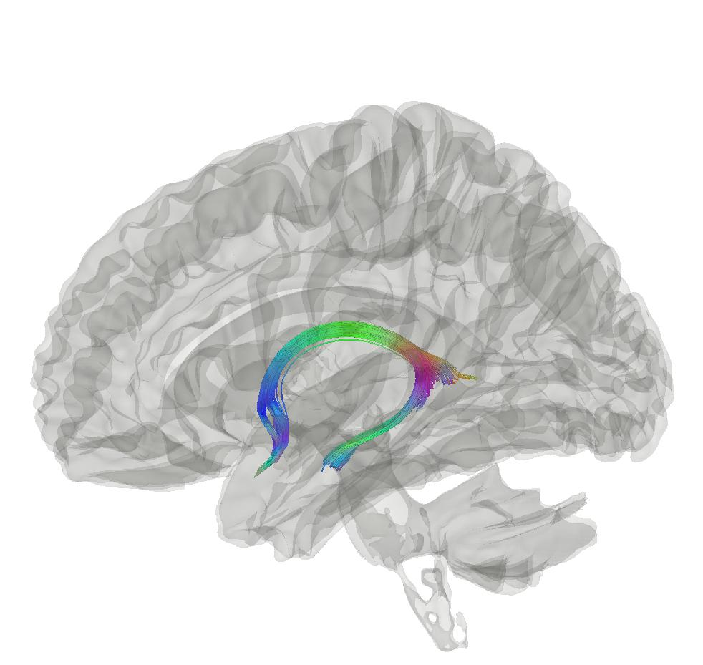



Brain-wide associations between white matter and age: fornix microstructure drives brain age estimates
Max Korbmacher
PhD Student at Western Norway University of Applied Sciences, Bergen
Max.Korbmacher@hvl.no

Slide 2
Contents
Background
Brain ageing
Brain age gap
Diffusion MRI
Current Study
Methods
Results & Discussion

Slide 3
Background: brain ageing
Brain ageing
Researched from various angles, e.g. tissue types
Patterns of non-normative ageing might be telling for the development of symptoms & disorders¹
“Big data”
Reliable brain-wide assoc. require many participants
Growing data bases established; analyses require advanced techniques for meaningful outputs
Brain age gap is one alternative
1 Rutherford et al., 2022, Elife, 11; 2 Marek et al., 2022, Nat., 603(7902)

Slide 4
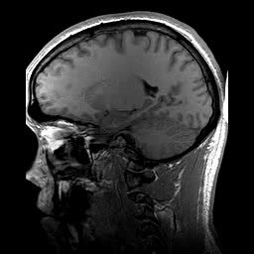
Background: brain age gap
Brain age gap (BAG) calculation
Train a model from MRI data
Make age prediction per individual: “your brain is X years old”
Take the difference between chronological and predicted age
BAG associations
Related to a range of clinical outcomes¹
Higher in some clinical groups vs controls¹
Chronologically 22 years old
Age prediction
Biologically 23 years old
1 Franke & Gaser, 2019, Front. Neurol., 789

Slide 5
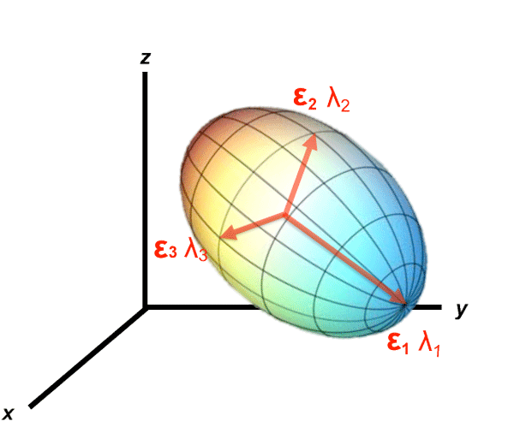
Background: diffusion MRI
Diffusion in the brain
Reveals valuable information about brain structure
Different approaches can be used to calculate diffusion
Most common DTI, but other biophysically more meaningful approaches available¹
e.g. assuming non-Gaussian diffusion (kurtosis) or adding priors (Bayesian approach)
1 Jensen et al., 2005, Magn. Reson. Med. 53

Slide 6
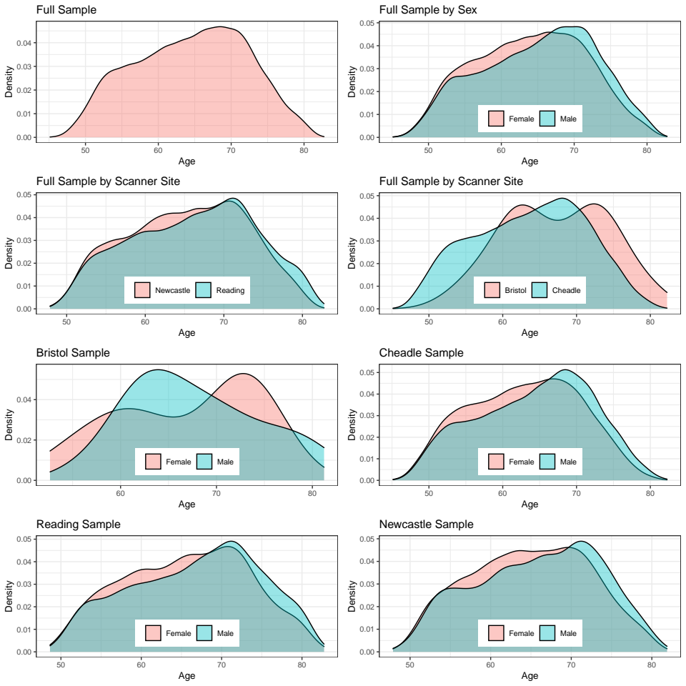
Methods
Participants (UKB)
Older sample (44.57 to 82.75 yoa)
Cross-sectional N = 35,749 after QC & exclusions
Sex ratio relatively balanced (F:53%, M:47%)
Scanner site not balanced
57.62% Cheadle
26.30% Newcastle
15.96% Reading
0.12% Bristol

Slide 7
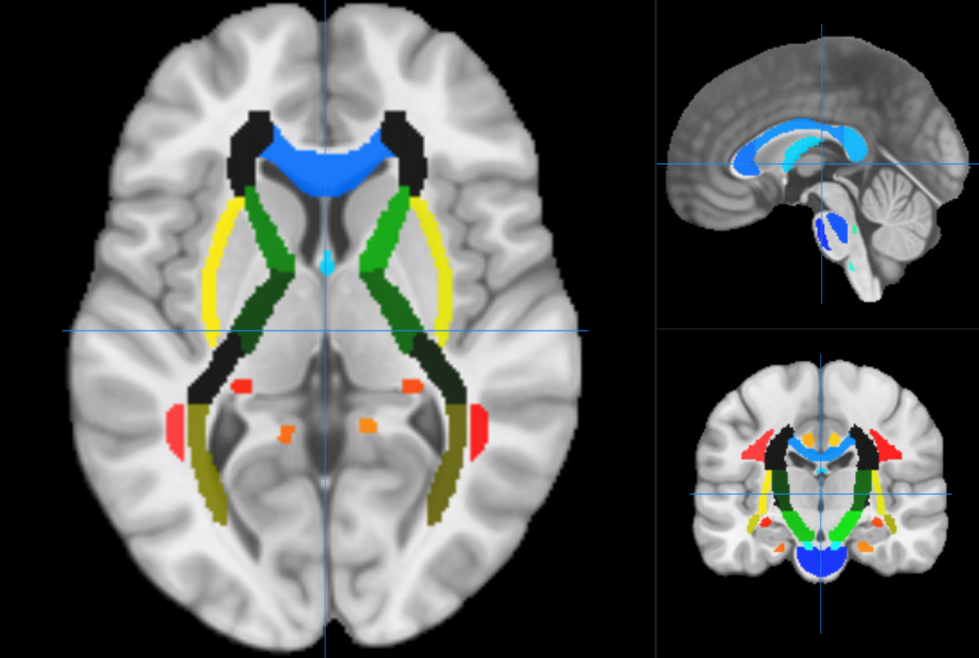
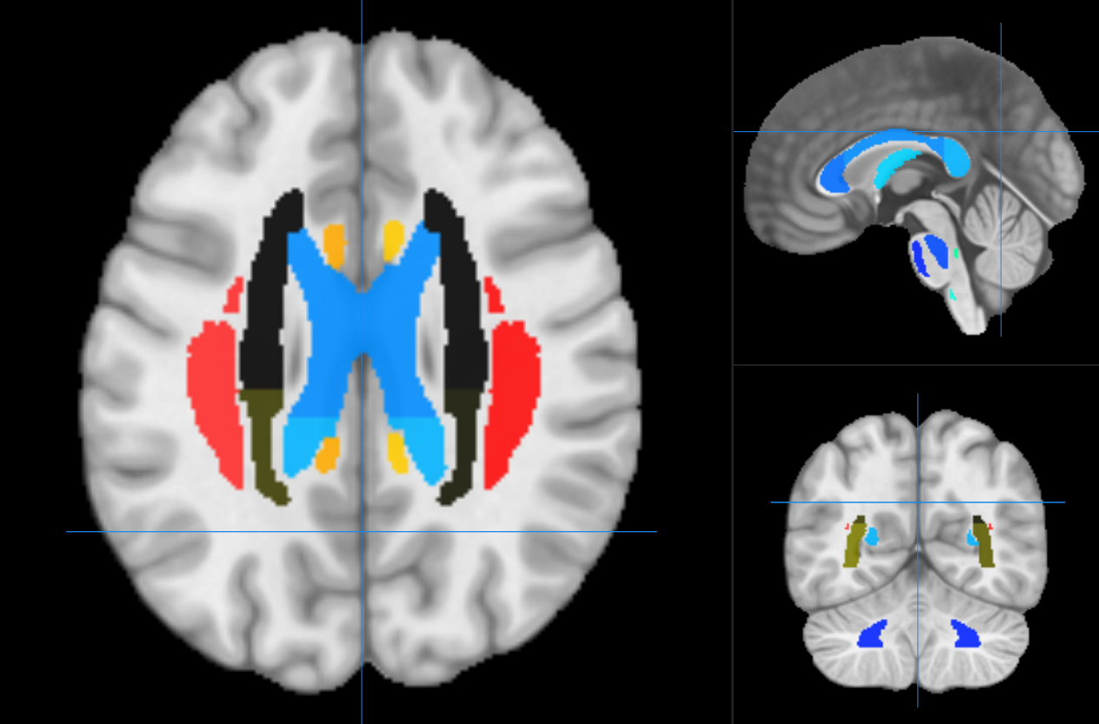
Methods
Data Processing
Six diffusion approaches calculated for JHU atlas
Diffusion Tensor Imaging (DTI) (4 metrics)
Diffusion Kurtosis Imaging (DKI) (3 metrics
Bayesian Rotationally Invariant Approach (BRIA) (10 metrics)
Spherical Mean Technique (SMT) (4 metrics)
multi-compartment SMT (mcSMT) (4 metrics)
White Matter Tract Integrity (WMTI) (3 metrics)
28 metrics x (20tracts + 48regions + 1mean) = 1932 diffusion features
Metrics inform about intra and extra axonal space, water fraction, fractional anisotropy
All being indicative of white matter characteristics, e.g. fiber density, axonal diameter, & myelination

Slide 8
Methods
Investigation
XGBoost for brain age predictions
Key questions:
Do brain age predictions from the six diffusion approaches differ?
Which are driving WM regions of ageing?
How does WM project on age?

Slide 9
Results
Investigation
Key questions:
Do brain age predictions from the six diffusion approaches differ?
Which are driving WM regions of ageing?
How does WM project on age?

Slide 10
Results
Brain age prediction model performance
Approach | MRI features | R² | RMSE | MAE | Prediction-Age Correlation | Corrected Prediction-Age Correlation
BRIA | 690 | 0.550 (0.012) | 5.007 (0.057) | 4.002 (0.042) | 0.742 [0.737, 0.747] | 0.892 [0.889, 0.894]
DKI | 207 | 0.576 (0.015) | 4.958 (0.077) | 3.975 (0.068) | 0.754 [0.755, 0.764] | 0.903 [0.901, 0.905]
DTI | 276 | 0.571 (0.014) | 4.983 (0.072) | 3.984 (0.062) | 0.756 [0.751, 0.761] | 0.900 [0.897, 0.902]
SMT | 276 | 0.531 (0.010) | 5.214 (0.053) | 4.183 (0.036) | 0.729 [0.724, 0.734] | 0.899 [0.897, 0.901]
mcSMT | 276 | 0.519 (0.011) | 5.175 (0.045) | 4.153 (0.036) | 0.721 [0.716, 0.726] | 0.892 [0.889, 0.894]
WMTI | 207 | 0.585 (0.012) | 4.903 (0.065) | 3.928 (0.050) | 0.765 [0.761, 0.770] | 0.902 [0.900, 0.904]
Mean multimodal | 28 | 0.393 (0.012) | 5.932 (0.051) | 4.812 (0.046) | 0.627 [0.621, 0.634] | 0.905 [0.903, 0.907]
Full multimodal | 1932 | 0.645 (0.011) | 4.534 (0.041) | 3.624 (0.037) | 0.804 [0.800, 0.808] | 0.907 [0.905, 0.909]

Slide 11
Results
Brain age prediction model performance
Approach | MRI features | R² | RMSE | MAE | Prediction-Age Correlation | Corrected Prediction-Age Correlation
BRIA | 690 | 0.550 (0.012) | 5.007 (0.057) | 4.002 (0.042) | 0.742 [0.737, 0.747] | 0.892 [0.889, 0.894]
DKI | 207 | 0.576 (0.015) | 4.958 (0.077) | 3.975 (0.068) | 0.754 [0.755, 0.764] | 0.903 [0.901, 0.905]
DTI | 276 | 0.571 (0.014) | 4.983 (0.072) | 3.984 (0.062) | 0.756 [0.751, 0.761] | 0.900 [0.897, 0.902]
SMT | 276 | 0.531 (0.010) | 5.214 (0.053) | 4.183 (0.036) | 0.729 [0.724, 0.734] | 0.899 [0.897, 0.901]
mcSMT | 276 | 0.519 (0.011) | 5.175 (0.045) | 4.153 (0.036) | 0.721 [0.716, 0.726] | 0.892 [0.889, 0.894]
WMTI | 207 | 0.585 (0.012) | 4.903 (0.065) | 3.928 (0.050) | 0.765 [0.761, 0.770] | 0.902 [0.900, 0.904]
Mean multimodal | 28 | 0.393 (0.012) | 5.932 (0.051) | 4.812 (0.046) | 0.627 [0.621, 0.634] | 0.905 [0.903, 0.907]
Full multimodal | 1932 | 0.645 (0.011) | 4.534 (0.041) | 3.624 (0.037) | 0.804 [0.800, 0.808] | 0.907 [0.905, 0.909]

Slide 12
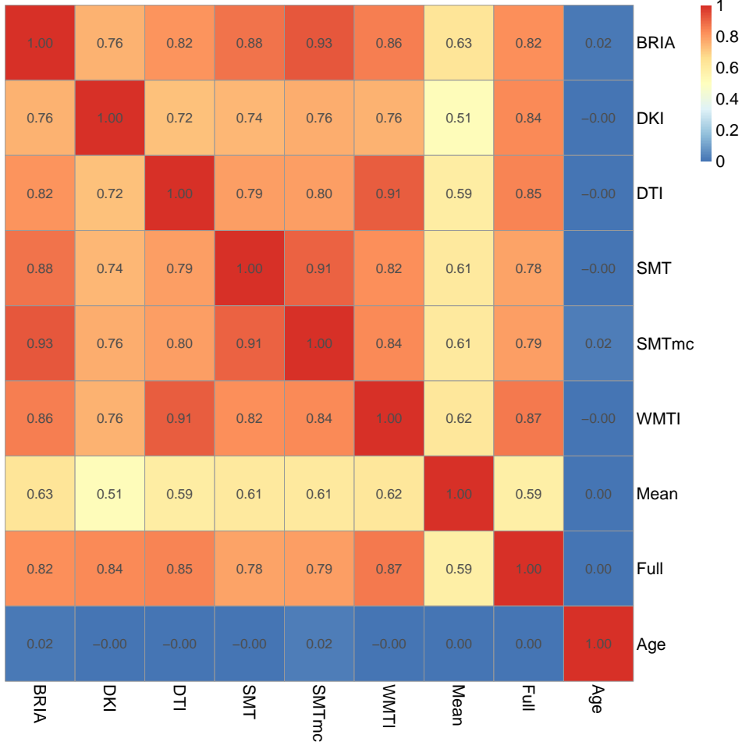
Results
Another aspect of assessing comparability across diffusion approaches: BAG
Key message: corrected BAG strongly related across models
Correlations of corrected BAG and age across diffusion approaches

Slide 13
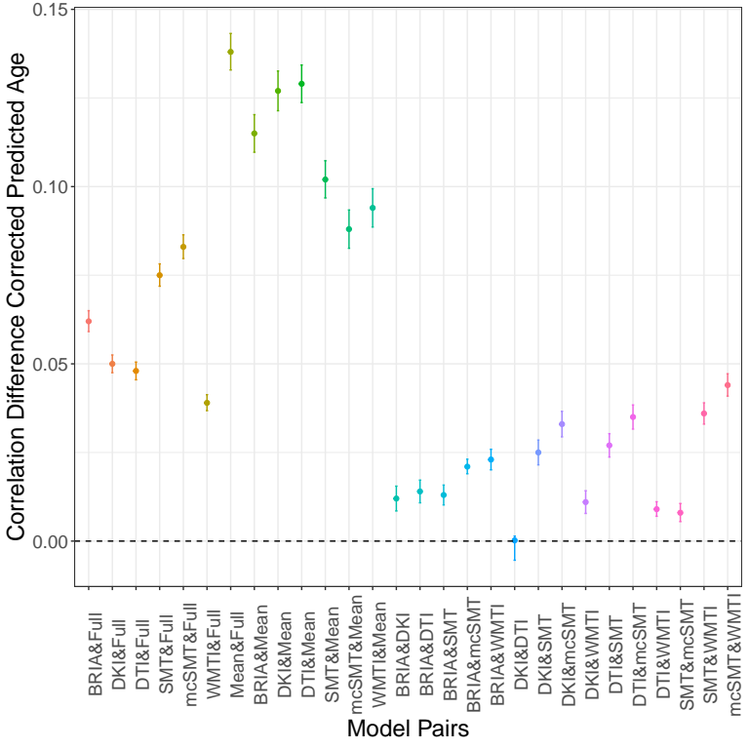
Results: uncorrected predictions
Differences in model performance for uncorrected brain age was small across diffusion approaches
Approach | MRI features | R² | RMSE | MAE | Prediction-Age Correlation | Corrected Prediction-Age Correlation
BRIA | 690 | 0.550 (0.012) | 5.007 (0.057) | 4.002 (0.042) | 0.742 [0.737, 0.747] | 0.892 [0.889, 0.894]
DKI | 207 | 0.576 (0.015) | 4.958 (0.077) | 3.975 (0.068) | 0.754 [0.755, 0.764] | 0.903 [0.901, 0.905]
DTI | 276 | 0.571 (0.014) | 4.983 (0.072) | 3.984 (0.062) | 0.756 [0.751, 0.761] | 0.900 [0.897, 0.902]
SMT | 276 | 0.531 (0.010) | 5.214 (0.053) | 4.183 (0.036) | 0.729 [0.724, 0.734] | 0.899 [0.897, 0.901]
mcSMT | 276 | 0.519 (0.011) | 5.175 (0.045) | 4.153 (0.036) | 0.721 [0.716, 0.726] | 0.892 [0.889, 0.894]
WMTI | 207 | 0.585 (0.012) | 4.903 (0.065) | 3.928 (0.050) | 0.765 [0.761, 0.770] | 0.902 [0.900, 0.904]
Mean multimodal | 28 | 0.393 (0.012) | 5.932 (0.051) | 4.812 (0.046) | 0.627 [0.621, 0.634] | 0.905 [0.903, 0.907]
Full multimodal | 1932 | 0.645 (0.011) | 4.534 (0.041) | 3.624 (0.037) | 0.804 [0.800, 0.808] | 0.907 [0.905, 0.909]

Slide 14
Results
Investigation
Key questions:
Do the results from the six diffusion approaches differ?
Which are driving WM regions of ageing?
How does WM project on age?

Slide 15
Results: model performance
Fornix metrics contribute most to accurate age predictions (gain)
Top five diffusion metrics ranked by gain in age prediction accuracy
BRIA | DKI | DTI | SMT | mcSMT | WMTI | Multimodal
Micro FA fornix (54957) | MK fornix (39662) | MD fornix (50535) | MD fornix (43563) | Intra fornix (38043) | AWF fornix (52531) | Micro FA Fornix (67749)
Micro RD right external capsule (22860) | RK fornix (26954) | RD FMIN (18386) | MD right anterior corona radiata (24675) | Extra trans Fornix (35799) | RadEAD ATRL (12328) | RD Fornix right Striaterminalis (17664)
Micro FA FMIN (10081) | AK right anterior limb of internal capsule (16340) | RD fornix right stria terminalis (15431) | MD SLFR (19451) | Extratrans right external capsule (15369) | RadEAD right anterior corona radiata | AK anterior right limb of internalcapsule (17664)
Micro FA fornix right stria terminlis (9853) | AK fornix | AD fornix (9637) | MD FMIN (13527) | Extra MD anterior left limb of internalcapsule (6254) | RadEAD IFOFR (9828) | RadEAD right anterior corona radiata (17375)
Micro RD Fornix right stria terminalis (9812) | AK left superior frontooccipital fasciculus | FA fornix left striaterminalis (9283) | FA fornix (12011) | Extra trans anterior right limb of internalcapsule (6126) | RadEAD right external capsule (9793) | RadEAD SLFR (15840)

Slide 16
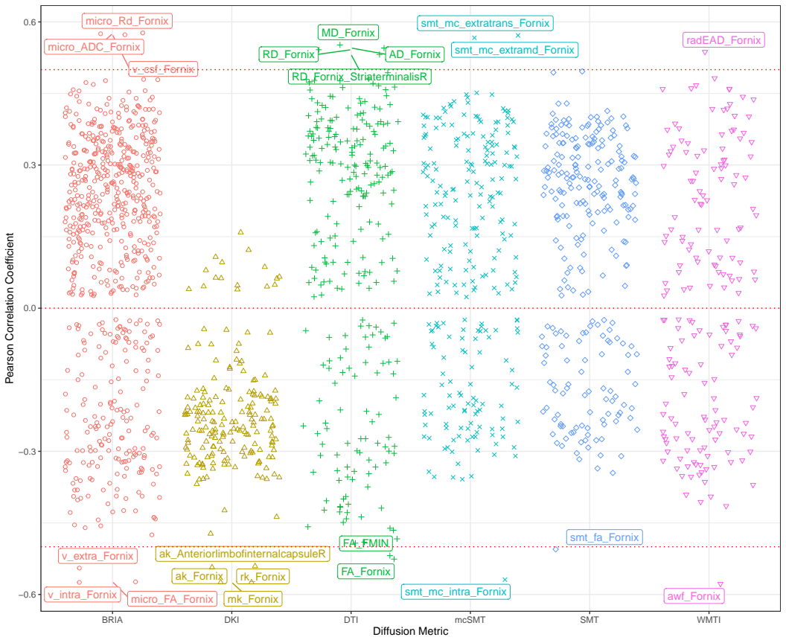
Results: age-metric associations
Fornix contributions to age predictions are reflected in correlations
Strongest age-metric correlations in fornix
Correlations between diffusion metrics and age (scattered)

Slide 17
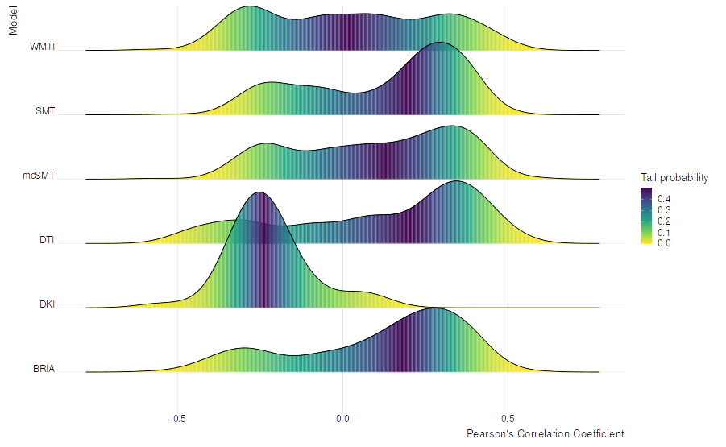
Results: age-metric associations
Fornix contributions to age predictions are reflected in correlations
Strongest age-metric correlations in fornix
Correlations between diffusion metrics and age (distributions)

Slide 18
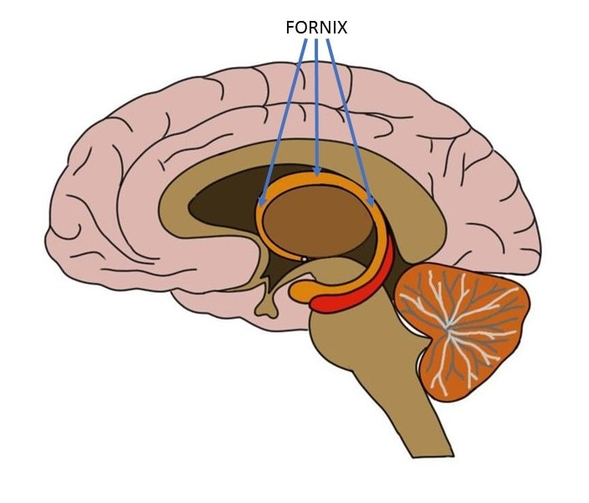
Results
Changes in Fornix throughout ageing?
Fornix = hippocampal output tract, part of limbic system
Cutting it causes recall memory problems
Close to hippocampus which has strong associations with ageing, age-disorders and cognition (esp. memory)
Previously associated with resting state activity in 10,000 UKB participants¹
Is the fornix an integral part of brain networks?
1 Kernbach et al., 2018, PNAS

Slide 19
Results
Investigation
Key questions:
Do brain age predictions from the six diffusion approaches differ?
Which are driving WM regions of ageing?
How does WM project on age?

Slide 20
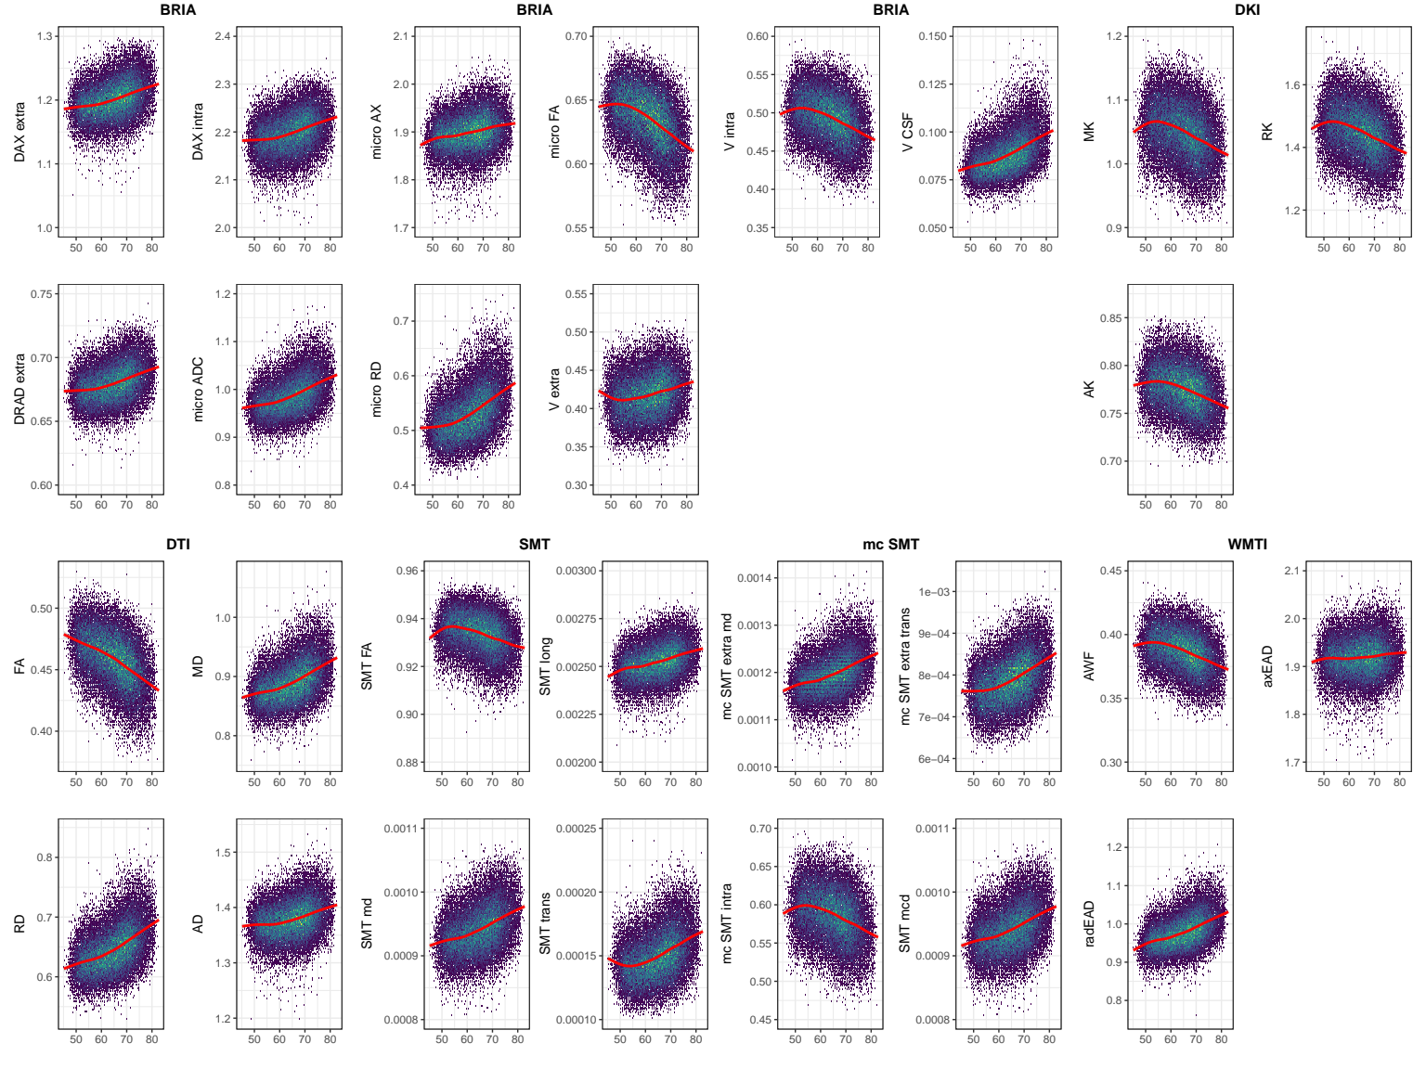
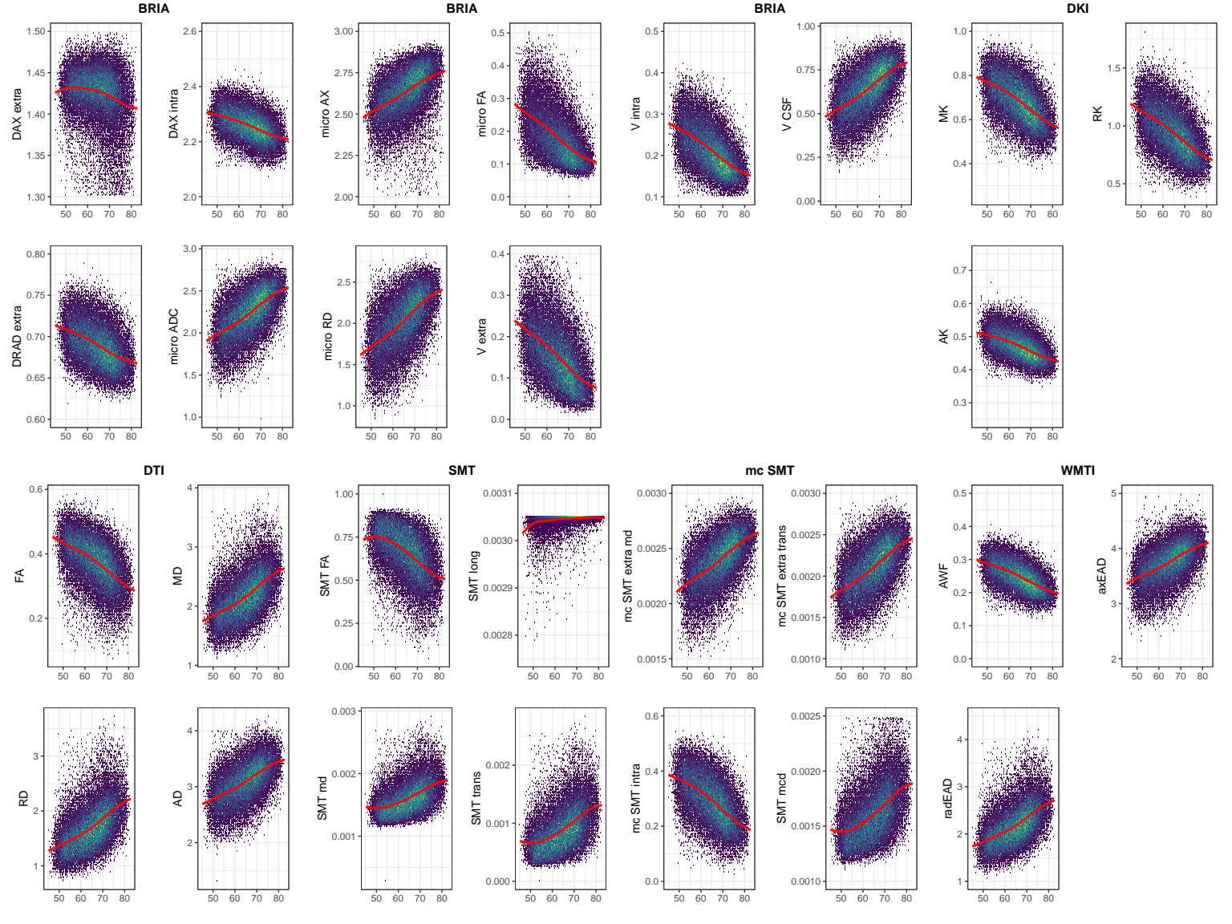
Results: age trajectories
The 28 diffusion metrics in fornix (lower fig) are more age sensitive than global measures (left)
Stronger relationship of axonal water fractions & age for fornix, suggesting quicker WM deterioration
Stronger fornix radial diffusivity age indicative of higher fornix plasticity?

Slide 21
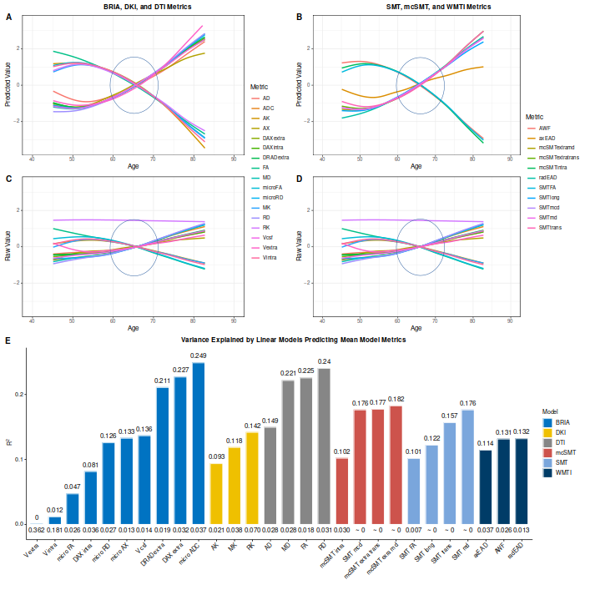
Results: normalised global trajectories
The 28 diffusion metrics follow quite tightly resembling lines when standardised (C-D) and predicted from age, sex and site (A-D)
E: R² and SE

Slide 22
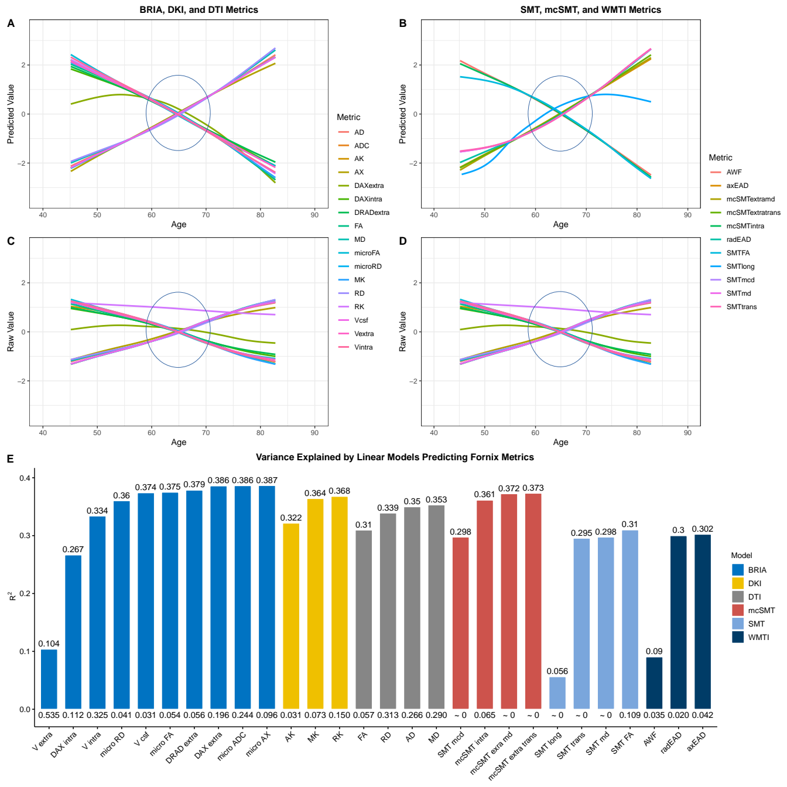
Results: normalised fornix trajectories
The 28 diffusion metrics follow quite tightly resembling lines when standardised (C-D) and predicted from age, sex and site (A-D)
E: R² and SE, better models for fornix

Slide 23
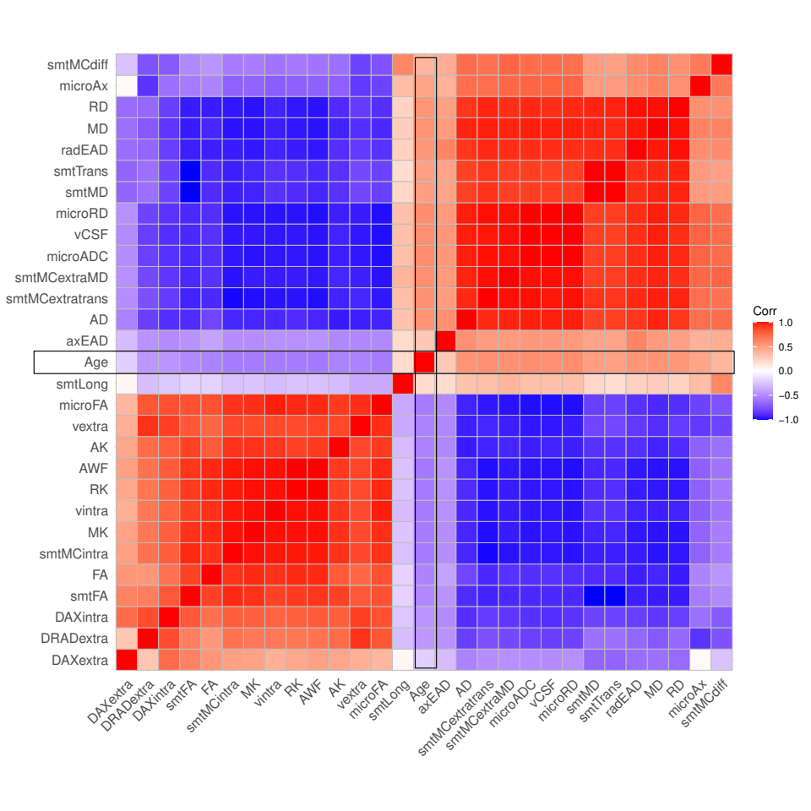
Results: fornix feat. associations
Fornix metrics across approaches were strongly related to each other
Two major clusters of fornix metrics (also reflected in age-curves)
Correlations between fornix diffusion metrics and age

Slide 24
Results: concluding remarks
Different diffusion approaches are similarly age-sensitive & measure similar properties as their brain age predictions and age-curves are closely assembling each other
However, combining approaches allows for more detail, leading to better brain age predictions
Fornix is potentially a key region of ageing worth further investigation

Slide 25


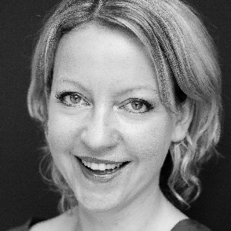





Ivan I. Maximov
Lars T. Westlye
Eli N. Eikefjord
Arvid Lundervold
Thank you!
Dennis van der Meer
Ann Marie de Lange
Dani Beck
Ole A. Andreassen

Slide 26
Supplementary slides

Slide 27
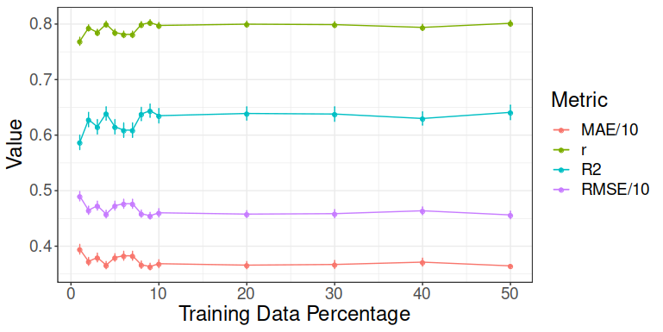
Methods
Model performance for different train-test splits using all data (1932 features, n = 35,749)
Trained models tested (10-fold cross val) on 50% data (opposite half of the highest train split) >> Train-test split fixed at 10%-90%

Slide 28
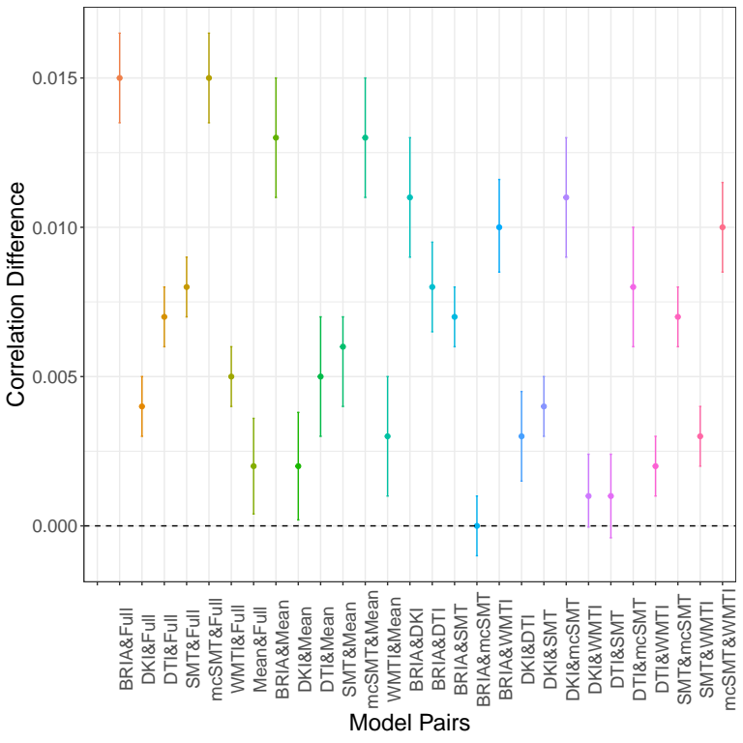
Results (corrected brain age model performance)
Small differences in model performance for corrected age
Approach | MRI features | R² | RMSE | MAE | Prediction-Age Correlation | Corrected Prediction-Age Correlation
BRIA | 690 | 0.550 (0.012) | 5.007 (0.057) | 4.002 (0.042) | 0.742 [0.737, 0.747] | 0.892 [0.889, 0.894]
DKI | 207 | 0.576 (0.015) | 4.958 (0.077) | 3.975 (0.068) | 0.754 [0.755, 0.764] | 0.903 [0.901, 0.905]
DTI | 276 | 0.571 (0.014) | 4.983 (0.072) | 3.984 (0.062) | 0.756 [0.751, 0.761] | 0.900 [0.897, 0.902]
SMT | 276 | 0.531 (0.010) | 5.214 (0.053) | 4.183 (0.036) | 0.729 [0.724, 0.734] | 0.899 [0.897, 0.901]
mcSMT | 276 | 0.519 (0.011) | 5.175 (0.045) | 4.153 (0.036) | 0.721 [0.716, 0.726] | 0.892 [0.889, 0.894]
WMTI | 207 | 0.585 (0.012) | 4.903 (0.065) | 3.928 (0.050) | 0.765 [0.761, 0.770] | 0.902 [0.900, 0.904]
Mean multimodal | 28 | 0.393 (0.012) | 5.932 (0.051) | 4.812 (0.046) | 0.627 [0.621, 0.634] | 0.905 [0.903, 0.907]
Full multimodal | 1932 | 0.645 (0.011) | 4.534 (0.041) | 3.624 (0.037) | 0.804 [0.800, 0.808] | 0.907 [0.905, 0.909]

Slide 29
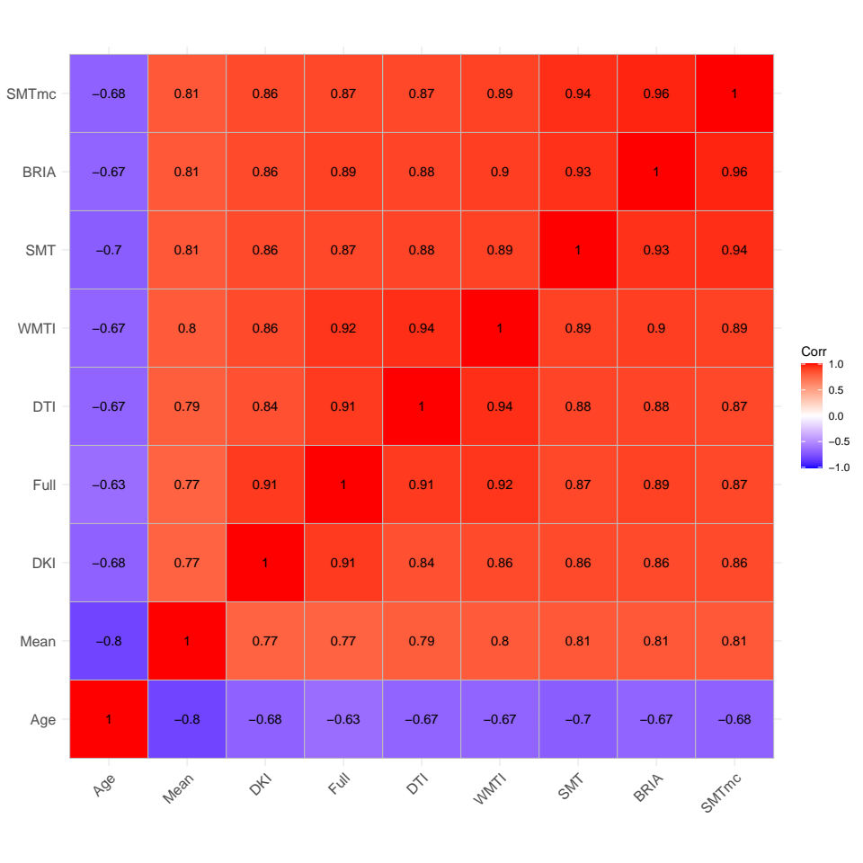
Results: uncorrected predictions
Correlations of uncorrected BAG and age across diffusion approaches
Associations between different diffusion approaches’ BAG are even stronger when NOT correcting for age

Slide 30
Linear?
Metric | LM AIC | GAM AIC | LM BIC | GAM BIC | LM R²_{adj} | GAM R²_{adj}
vintra | -126767.79 | -126755.60 | -126665.98 | -126662.27 | 0.36 | 0.36
vextra | -106952.81 | -106929.99 | -106851.00 | -106836.66 | 0.38 | 0.37
vCSF | -65781.67 | -65773.53 | -65679.86 | -65680.20 | 0.39 | 0.39
microRD | 633.36 | 643.11 | 735.18 | 736.43 | 0.39 | 0.39
microFA | -104706.06 | -104634.30 | -104604.25 | -104540.97 | 0.38 | 0.38
microAx | -54814.08 | -54790.59 | -54712.27 | -54697.26 | 0.27 | 0.27
microADC | -14954.91 | -14946.59 | -14853.10 | -14853.26 | 0.39 | 0.39
DRADextra | -177654.37 | -177648.58 | -177552.56 | -177555.25 | 0.30 | 0.30
DAXintra | -125641.12 | -125639.53 | -125539.31 | -125546.20 | 0.30 | 0.30
DAXextra | -138873.67 | -138808.20 | -138771.86 | -138714.87 | 0.09 | 0.09
RK | -34108.48 | -34109.41 | -34006.67 | -34016.08 | 0.37 | 0.37
AK | -146039.18 | -146041.08 | -145937.37 | -145947.75 | 0.32 | 0.32
MK | -85601.85 | -85603.57 | -85500.04 | -85510.24 | 0.36 | 0.36
FA | -103953.22 | -103924.62 | -103851.41 | -103831.30 | 0.31 | 0.31
MD | 12874.23 | 12878.93 | 12976.04 | 12972.25 | 0.35 | 0.35
RD | 18339.73 | 18359.69 | 18441.54 | 18453.02 | 0.34 | 0.34
AD | 6684.86 | 6689.75 | 6786.67 | 6783.08 | 0.35 | 0.35
smtFA | -57196.69 | -57161.31 | -57094.88 | -57067.98 | 0.31 | 0.31
smtLong | -686016.98 | -685869.48 | -685915.17 | -685776.15 | 0.06 | 0.05
smtMD | -507904.58 | -507869.45 | -507802.77 | -507776.13 | 0.30 | 0.30
smtTrans | -479144.23 | -479104.60 | -479042.42 | -479011.28 | 0.30 | 0.29
smtMCintra | -93427.21 | -93427.11 | -93325.40 | -93333.78 | 0.36 | 0.36
smtMCextraMD | -521137.14 | -521125.59 | -521035.33 | -521032.26 | 0.37 | 0.37
smtMCextratrans | -499929.78 | -499929.66 | -499827.97 | -499836.34 | 0.37 | 0.37
smtMCdiff | -575225.03 | -574996.85 | -575123.22 | -574903.53 | 0.22 | 0.21
AWF | -145979.93 | -145981.86 | -145878.11 | -145888.53 | 0.37 | 0.37
axEAD | 56711.05 | 56715.91 | 56812.86 | 56809.24 | 0.10 | 0.10
radEAD | 21189.85 | 21203.80 | 21291.67 | 21297.12 | 0.33 | 0.33
Also when allowing for splines, non-linear fit (GAM) was not better than linear models (LM) when predicting fornix features

Slide 31
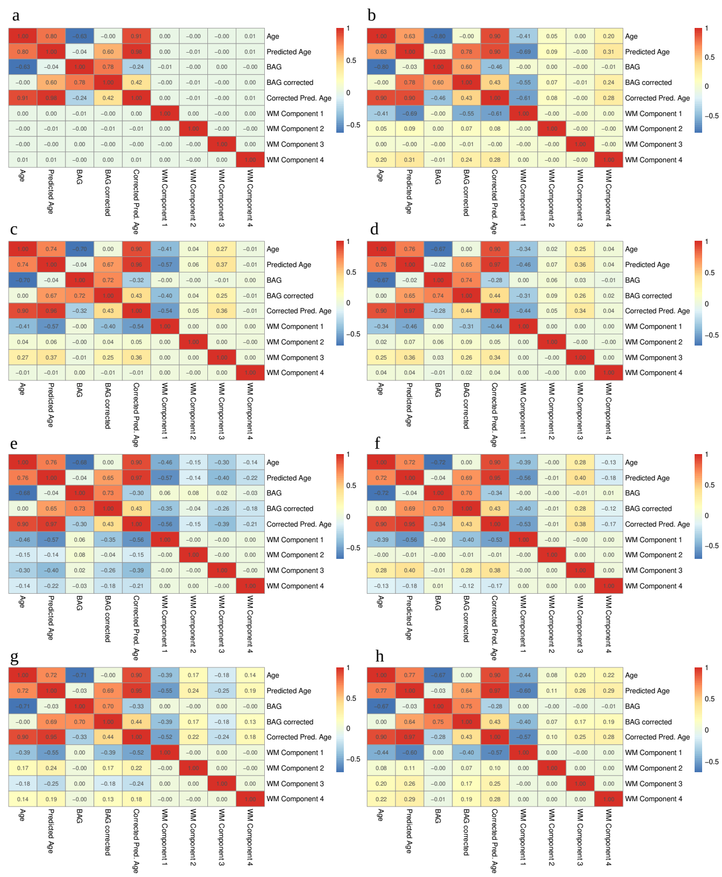
Missing BAG-WM relationships
Correlations of principal components, age, and brain age
a) full multimodal data, b) mean/whole brain average data, c) BRIA, d) DKI, e) DTI, f) SMT, g) SMT mc, h) WMTI

Slide 32
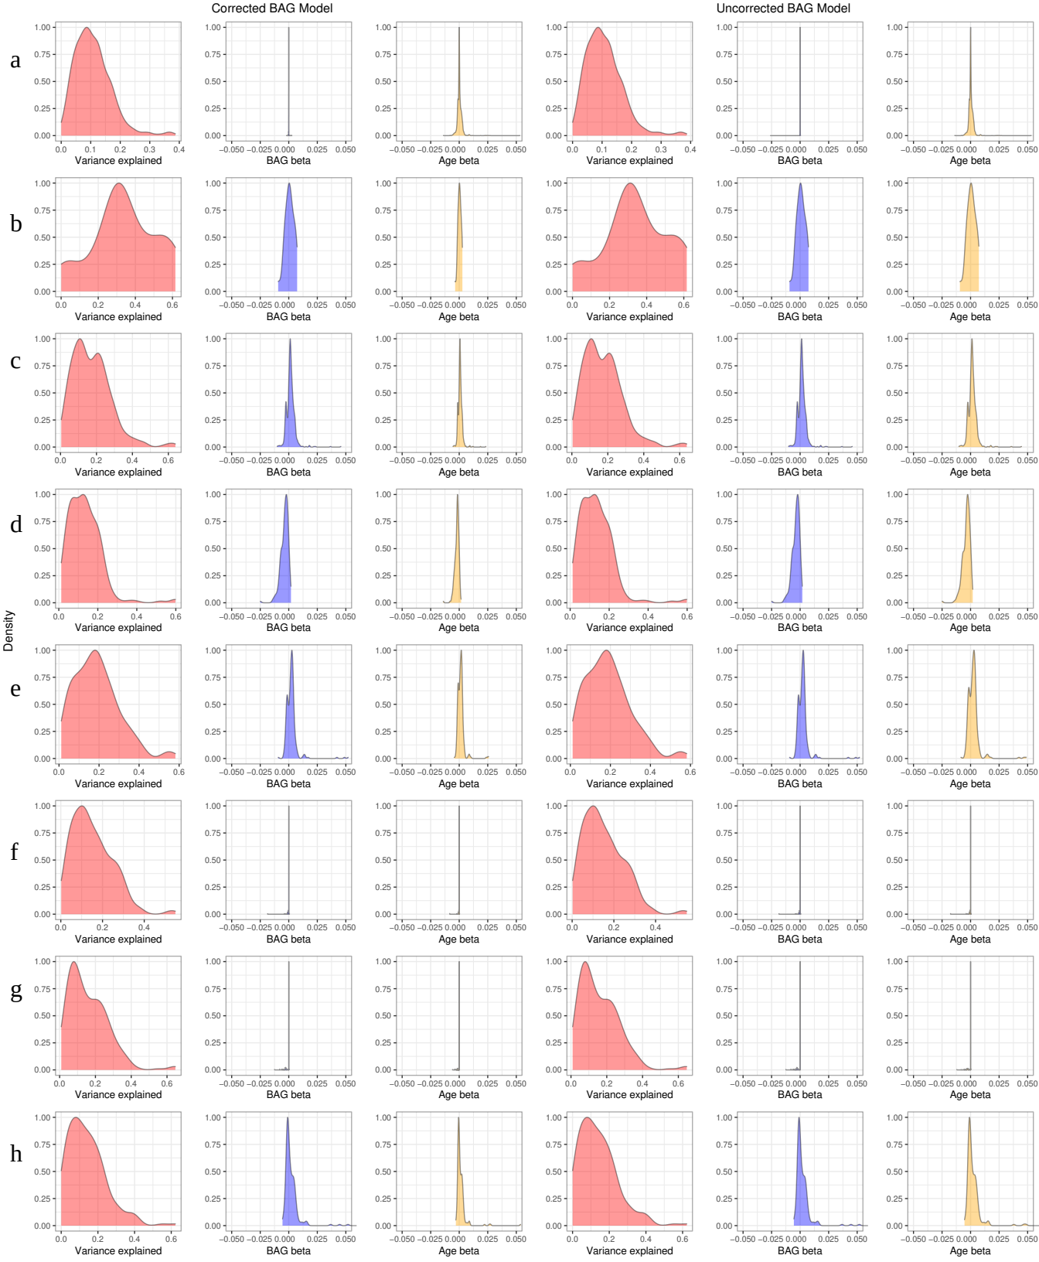
Missing BAG-WM relationships
Distributions of model stats for each predicted region
a) full multimodal data, b) mean/whole brain average data, c) BRIA, d) DKI, e) DTI, f) SMT, g) SMT mc, h) WMTI

